Slide 1

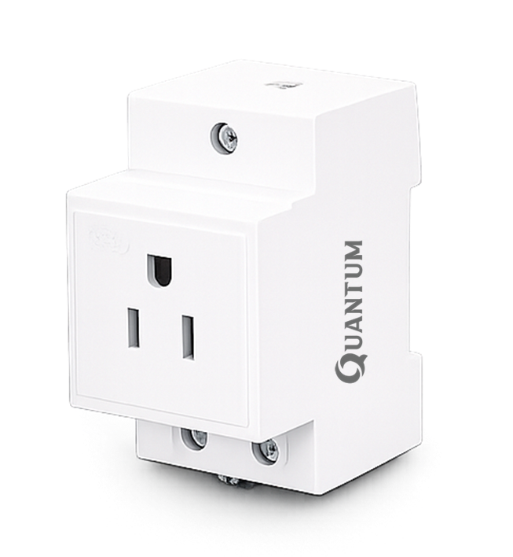
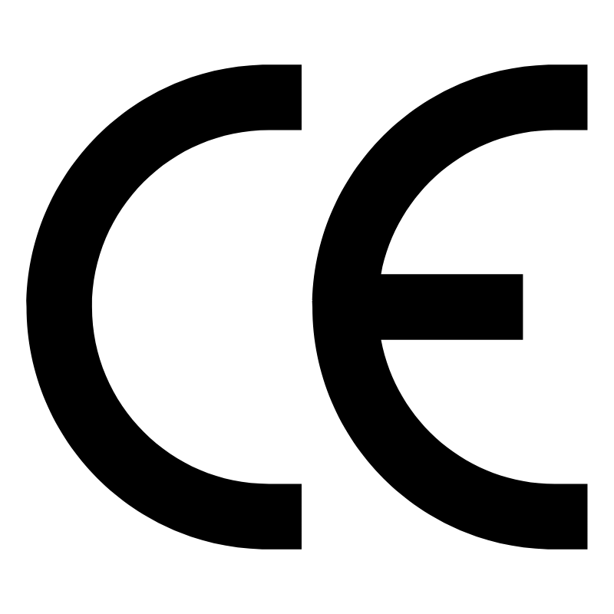

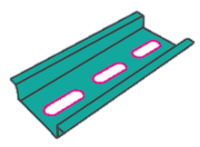

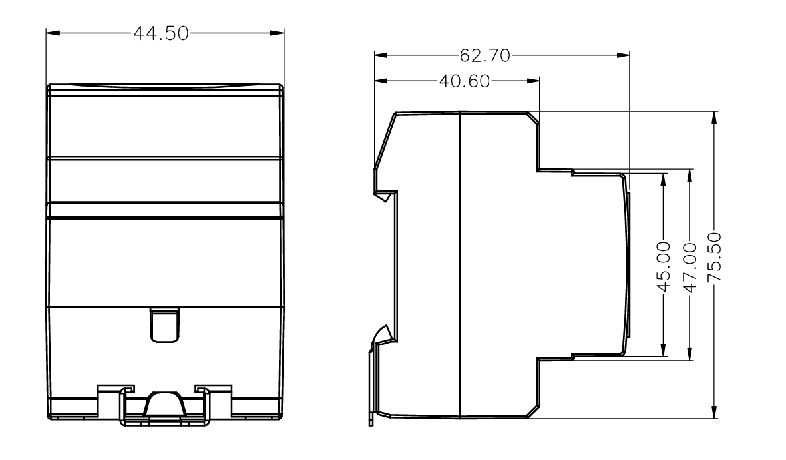
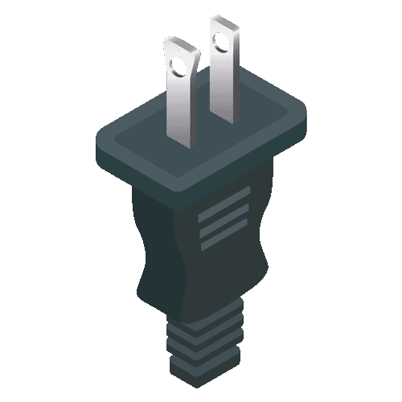
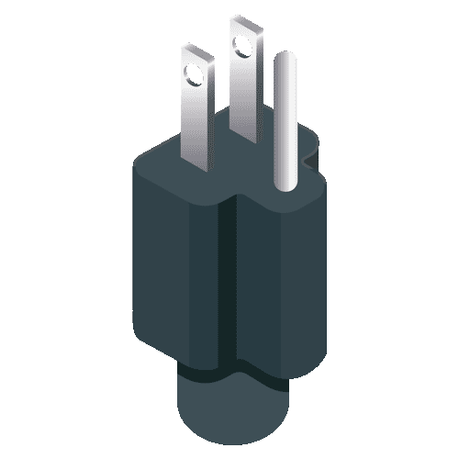
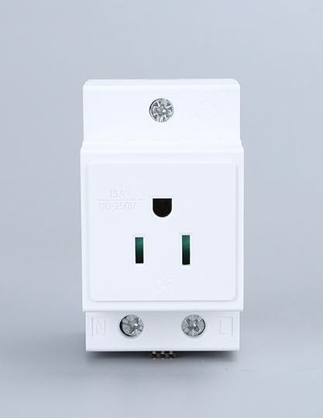
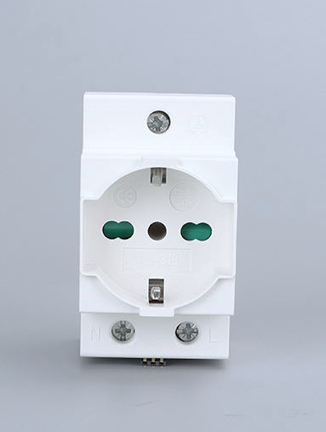
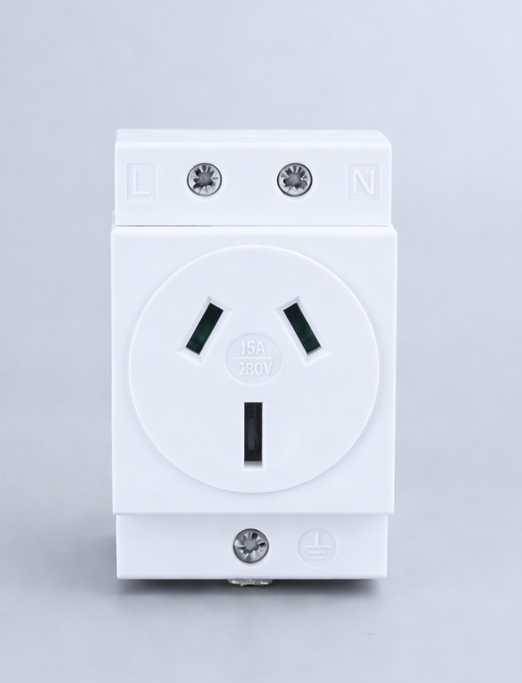
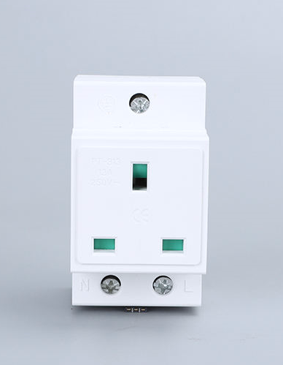
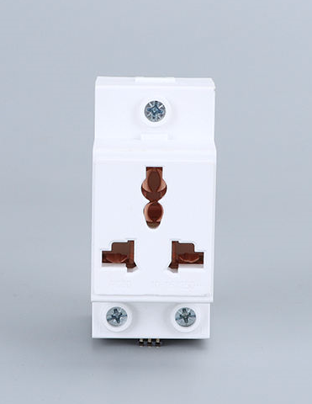
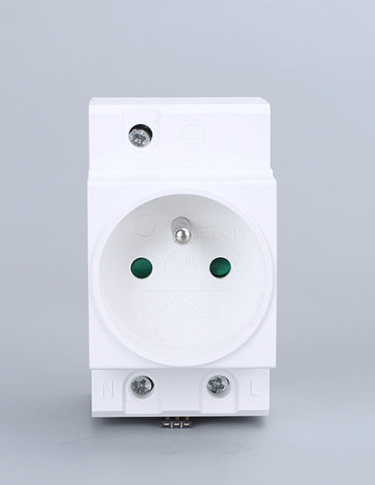
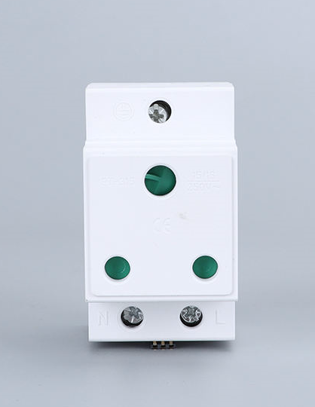
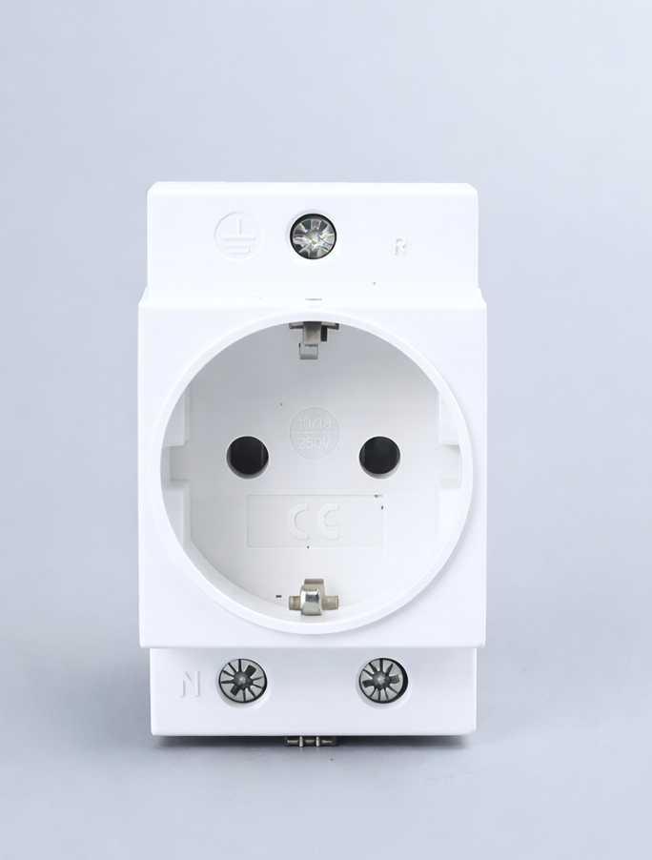
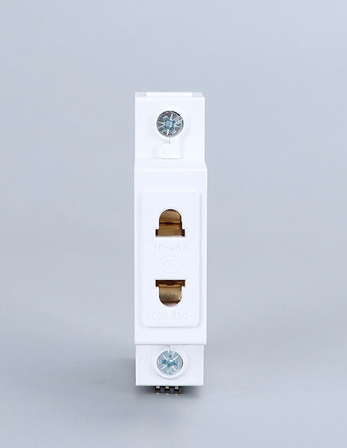
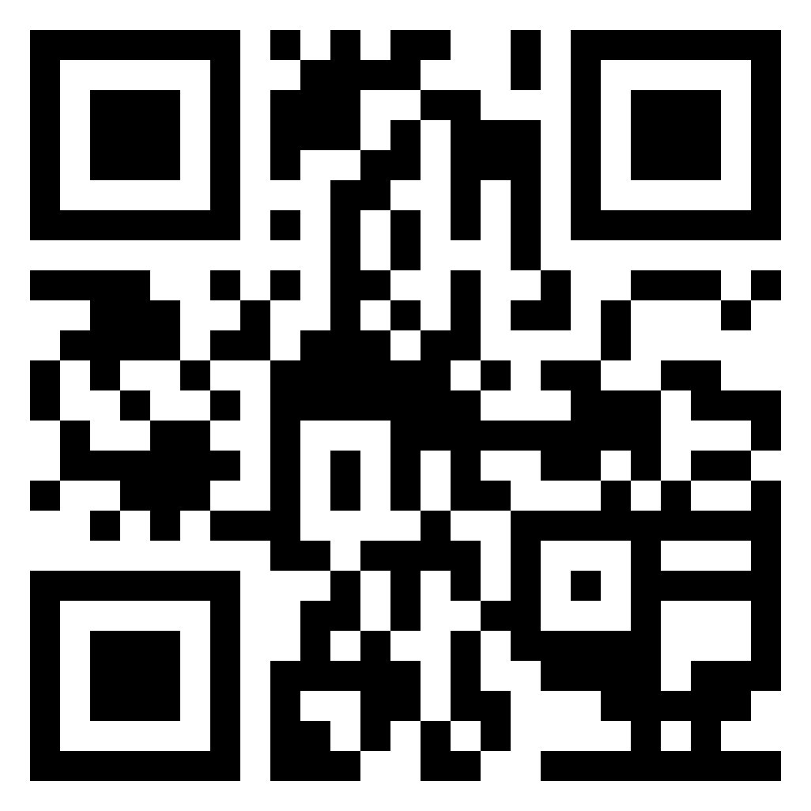
ELECTRICAL SOCKET
AC-30US - US - CANADA SOCKET
US Type
Quick Installation
DIN Rail Mount
IP20
Highly Reliable Performanc
Industrial Grade
2
Years Warranty
DIN Rail Mount
TECHNICAL PARAMETER
Supply Voltage | 250V AC 50/60 Hz
Nominal Current | 10-16 Amp
Mounting | Clip For 35mm Din Rail
Grounding | Standard Grounding
Type | US, Canada, Japan
Material | ABS+PC
Fitting Position | Variable
Color | White
Operating Temperature | -20 To +70°C
Weight | 100 gm
Dimensions | 76 x 63 x 45
Certification | CE, RoHS Compliance
DIMENSIONS
Support Type A & B
OTHER SOCKET
USA
ITALIAN
AUSTRALIA
UK/CANADA
UNIVERSAL
FRANCE
INDIAN
GERMAN
2 PIN
QTM ENGINEERING PVT LTD | QUANTUM AUTOMATION
Sales@QuantumGroups.in +91 97123 12346
Copyright @Quantum Group All Rights Reserved
* All specifications and photos are subject to change without notice

